Slide 1
Genomic Visualization Part 2
HUGEN 2073
Genomic Data Visualization & Integration
Slides adapted from Ryan Minster with permission

Slide 2
Learning Objectives
By the end of the session, students will be able to:
Create Manhattan and QQ plots for genome-wide statistics
Create regional Manhattan plots (LocusZoom plots)
Use basic ggbio commands to create chromosome ideograms and plots of genes

Slide 3
Manhattan Plots

Slide 4
Principles
x axis: genomic position (chr:bp)
y axis: −log₁₀ p
Point colors
Distinguish chromosomes
Distinguish important features
statistical significant “loci” (sometimes also point size)
known vs novel “loci”
Reference lines
Genome-wide statistical significance (5 × 10⁻⁸)
Suggestive significance (often 10⁻⁵ or 10⁻⁶)

Slide 5
Code
Examples: genome.sph.umich.edu/wiki/Code_Sample:_Generating_Manhattan_Plots_in_R
Examples: https://r-graph-gallery.com/101_Manhattan_plot.html
Data: chromosome and position, p values from GWAS, SNP ID
library(qqman) manhattan(results, chr = "CHR", bp = "BP", snp = "SNP", p = "P" )

Slide 6
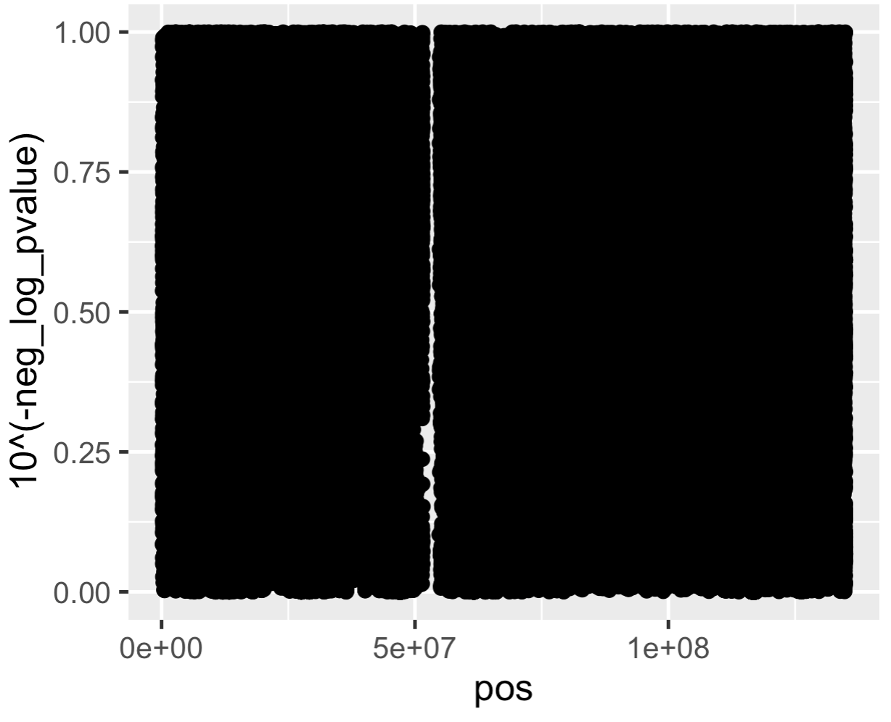
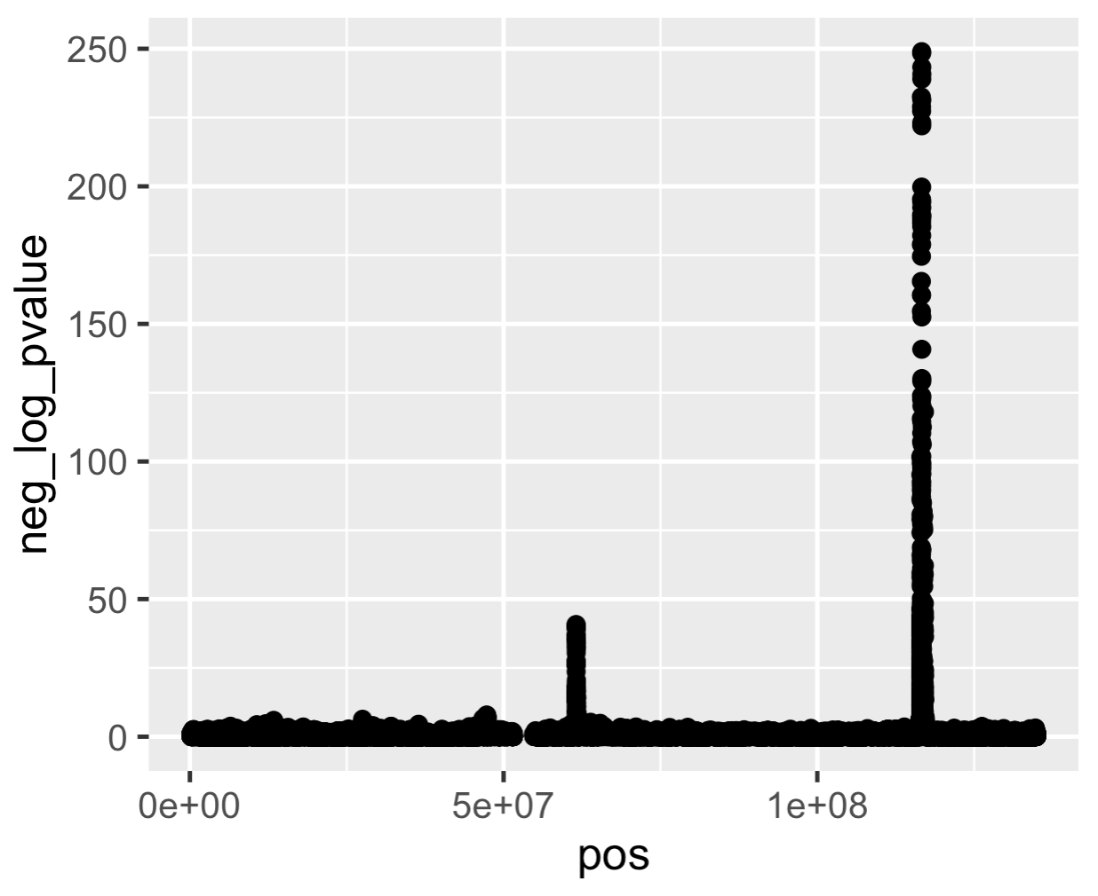
Why −log₁₀ p?
p values are usually transformed
Interesting p values (< 0.05) are compressed, and visually their differences are miniscule—whereas differences we don’t care about like between p = 0.5 and p = 0.7 are large and visible
−log₁₀ p rescales p so that the interesting differences are visible
The difference between 0.00000005 and 0.00001 is invisible but the difference between 7.3 and 5.0 is visible.
p
Chr 11 Position
−log₁₀ p
Chr 11 Position
Data for plots from Willer et al. Nat Genet 2013

Slide 7
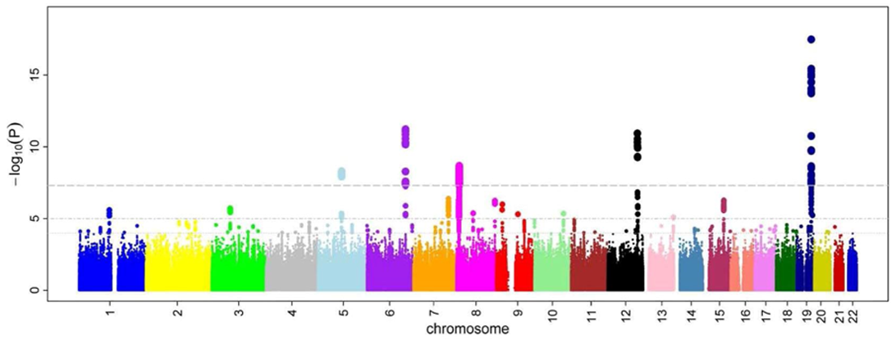
Variations
Ikram et al. PLoS Genet. 2010

Slide 8
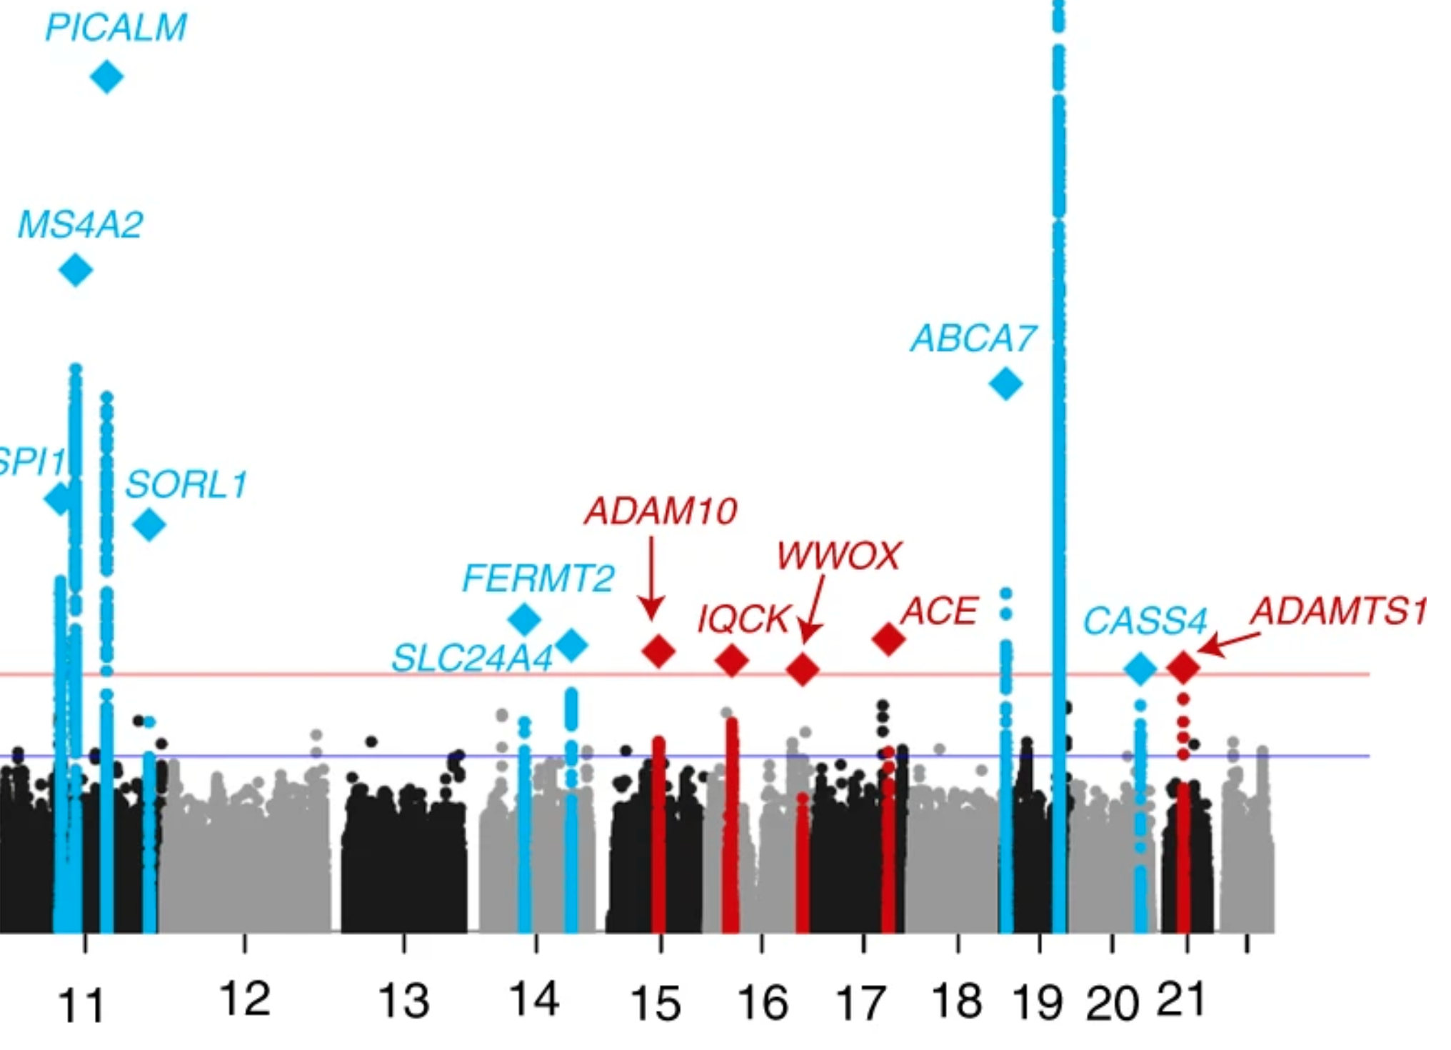
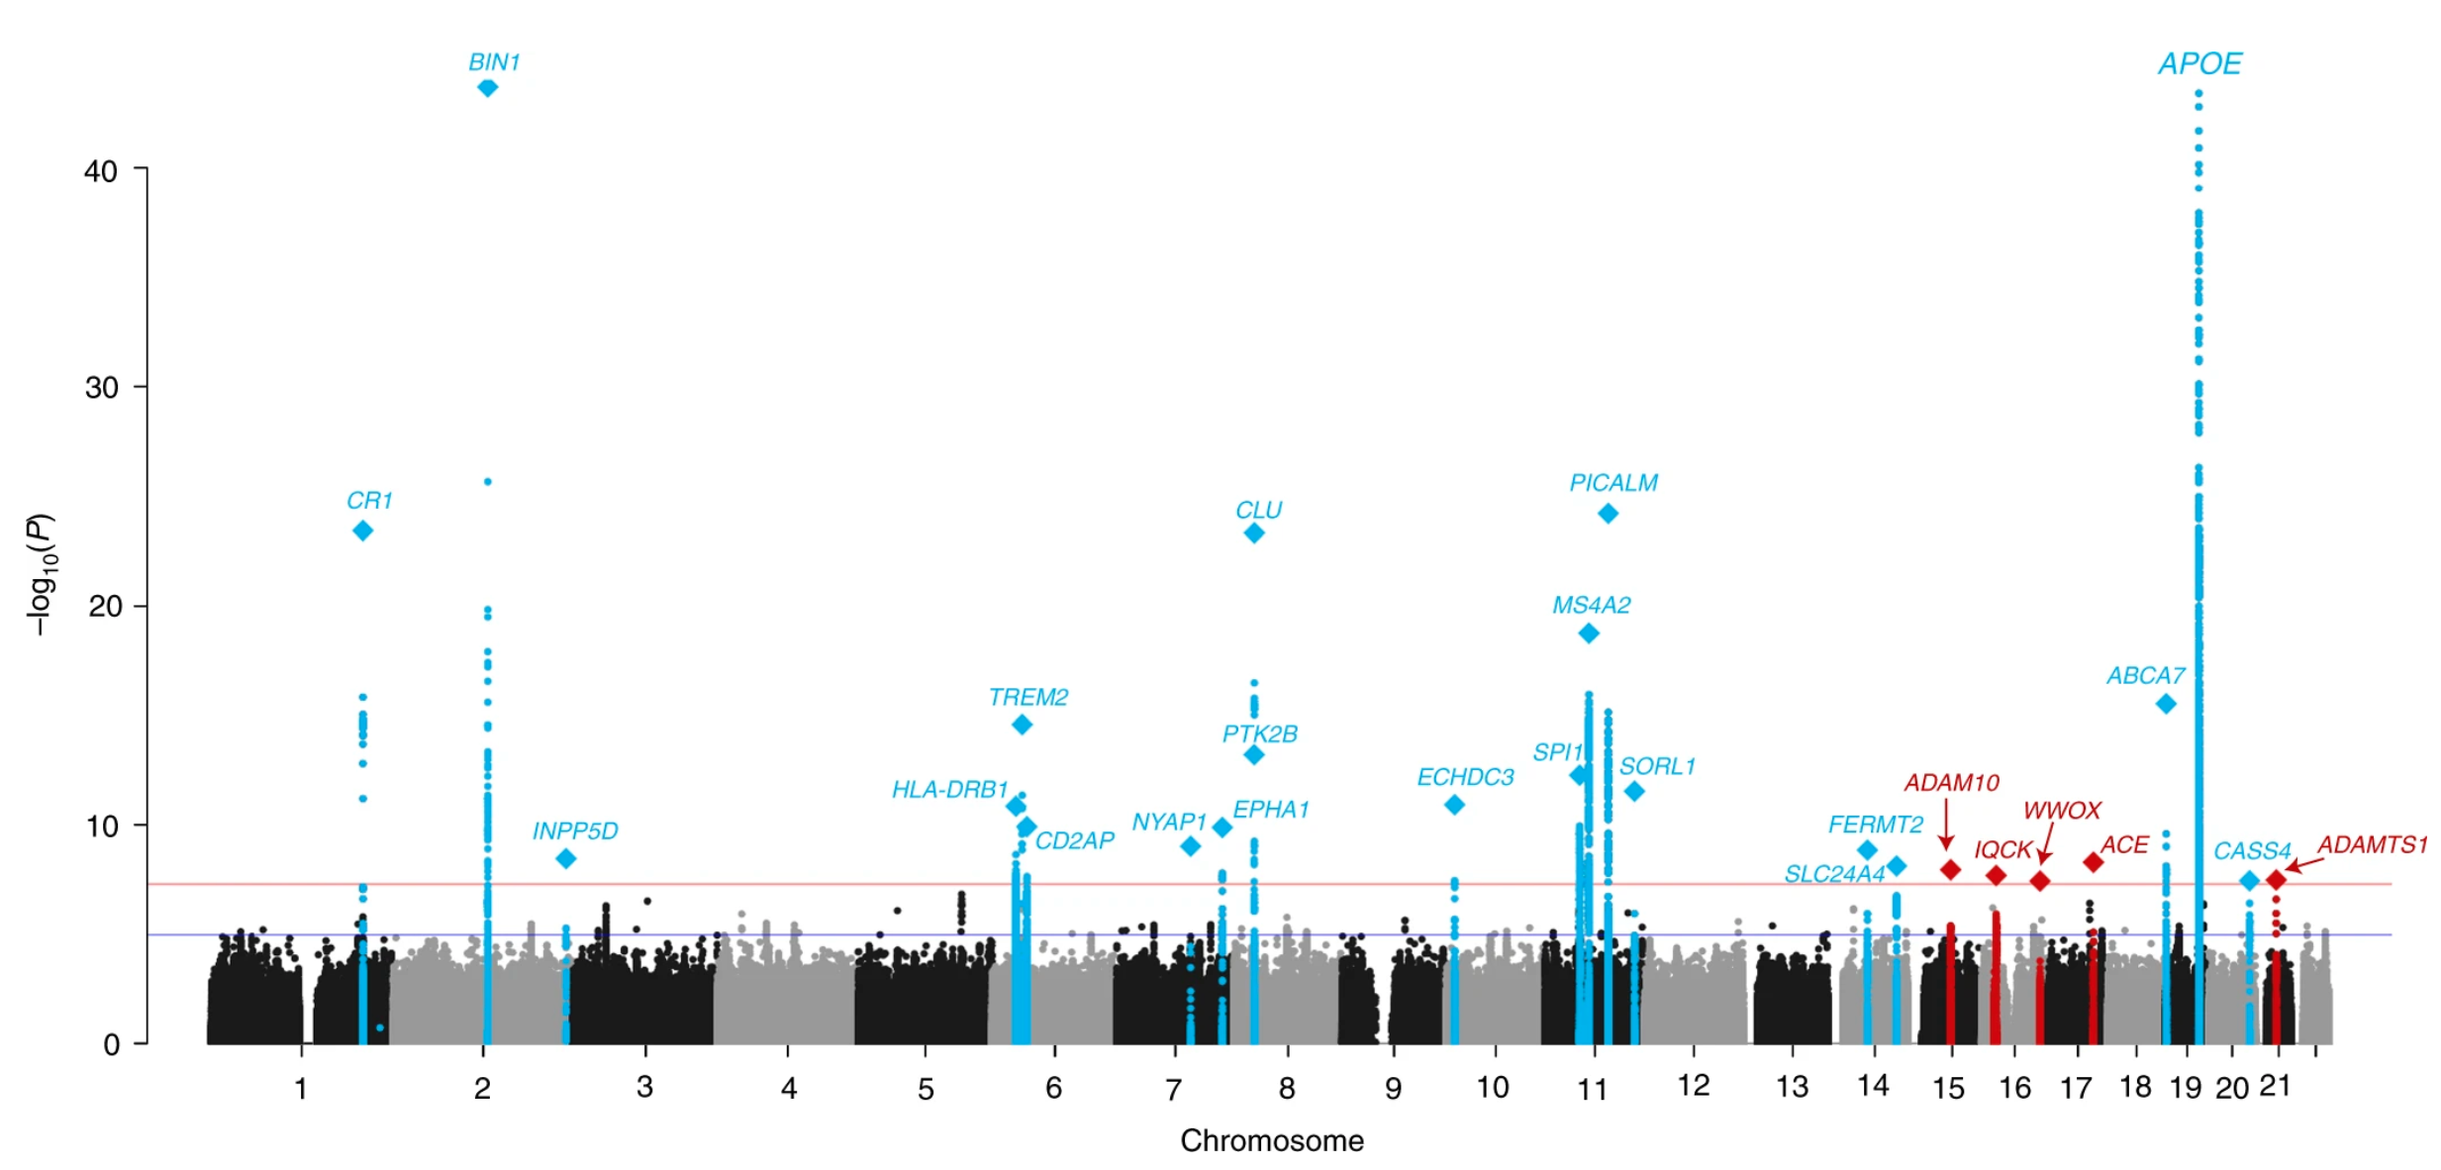
Variations
Kunkle et al. Nat. Genet. 2019

Slide 9
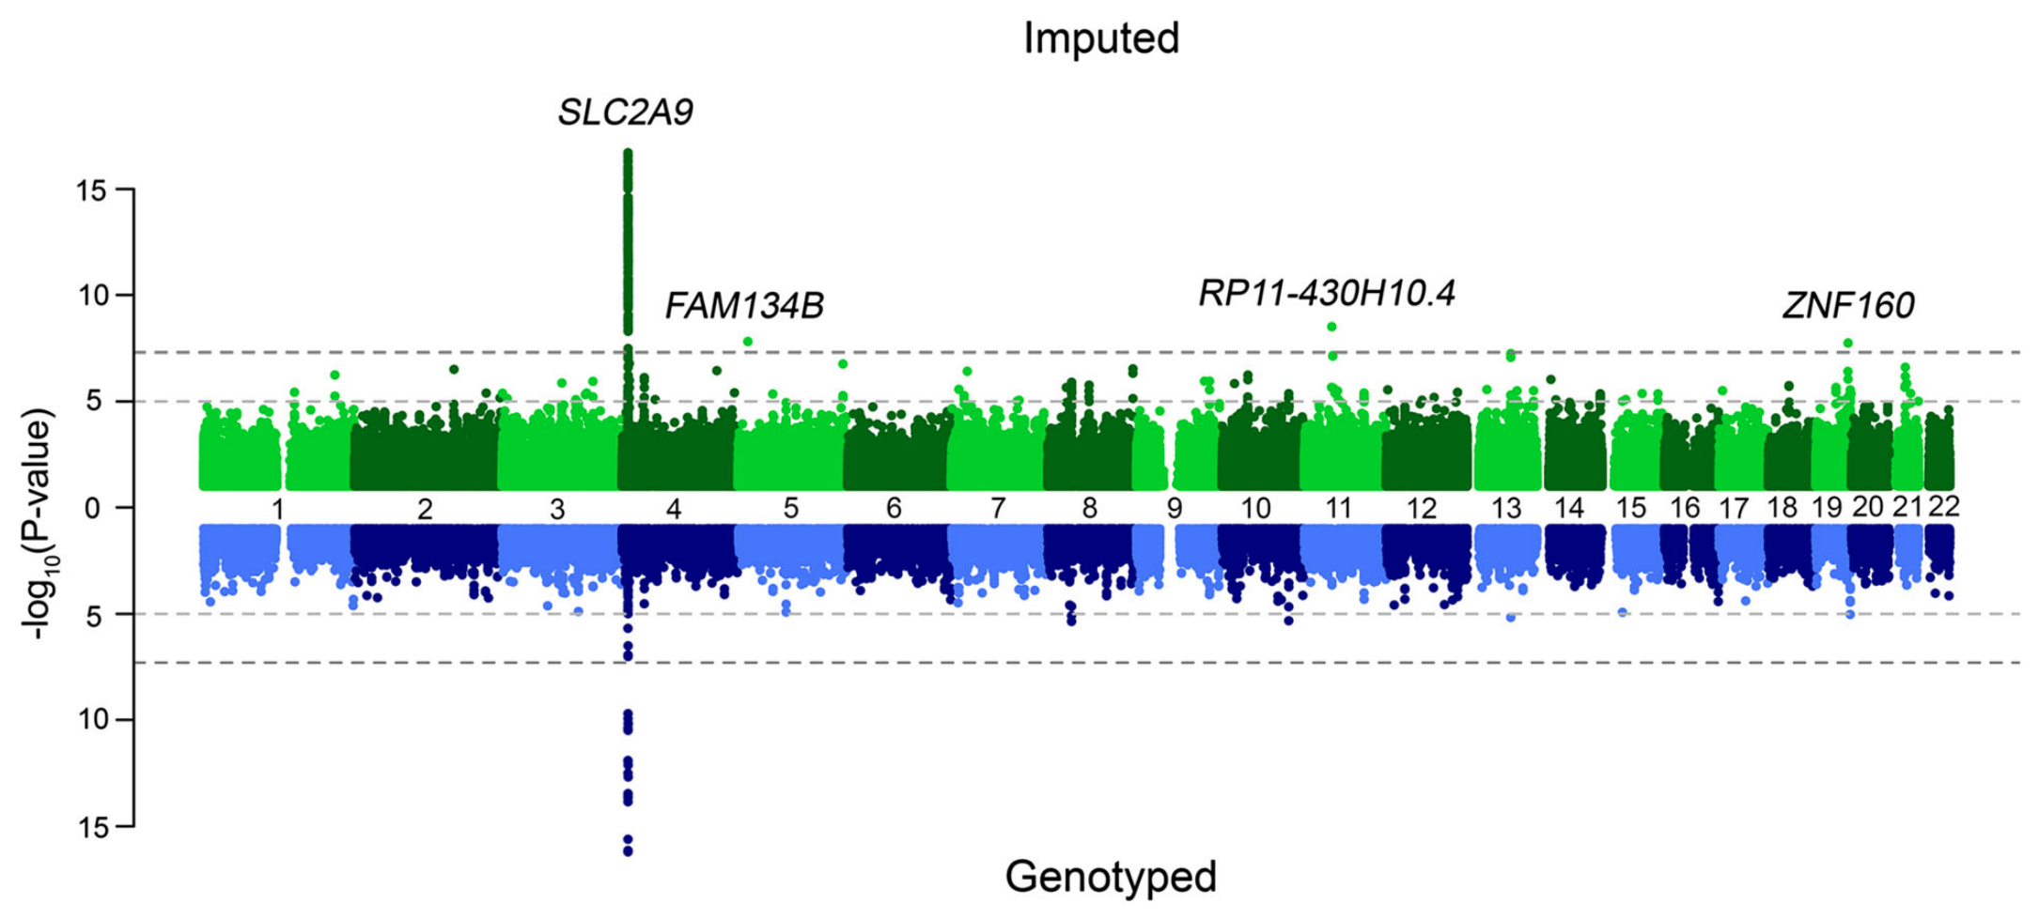
Miami Plots
Nagy et al. Genome Medicine 2017

Slide 10
Beyond Association Test p Values
Any point statistic can be used in a Manhattan-style plot
Most common is p value (−log₁₀ p)
You could plot t or F or χ² statistics — why not?
Population genetics statistics (F_{ST}, r ², D′, PBS, nS_{L})

Slide 11
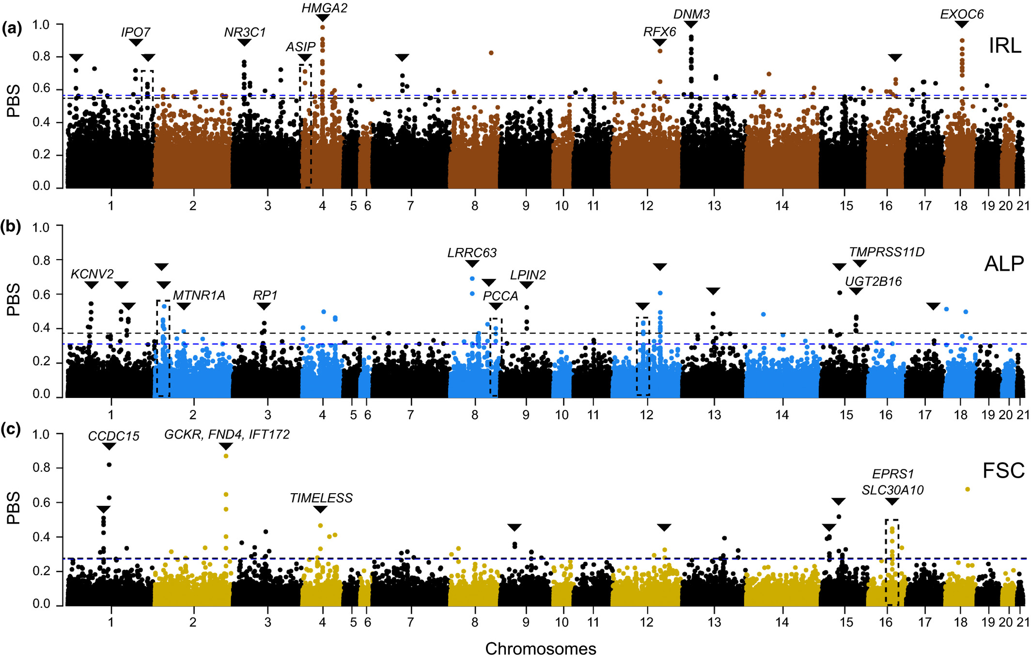
Natural Selection
Giska et al. Molec Ecol. 2022

Slide 12
Shortcuts
Reduce quantity of points to be plotted
Plot only points −log₁₀ p > 2
98.998% of points in a GWAS will be below this threshold
Takes 1.5 million points down to 15,028
Plot only random subset of points −log₁₀ p < 5
Plot subset of chromosomes

Slide 13
QQ Plots

Slide 14
Principles
x axis: expected −log₁₀ p
y axis: observed −log₁₀ p
Reference lines
y = x (identity line)
Confidence interval

Slide 15
Code
Examples: genome.sph.umich.edu/wiki/Code_Sample:_Generating_QQ_Plots_in_R
Examples: https://r-graph-gallery.com/101_Manhattan_plot.html
Data: p values from GWAS
library(qqman) qq(results$p)

Slide 16
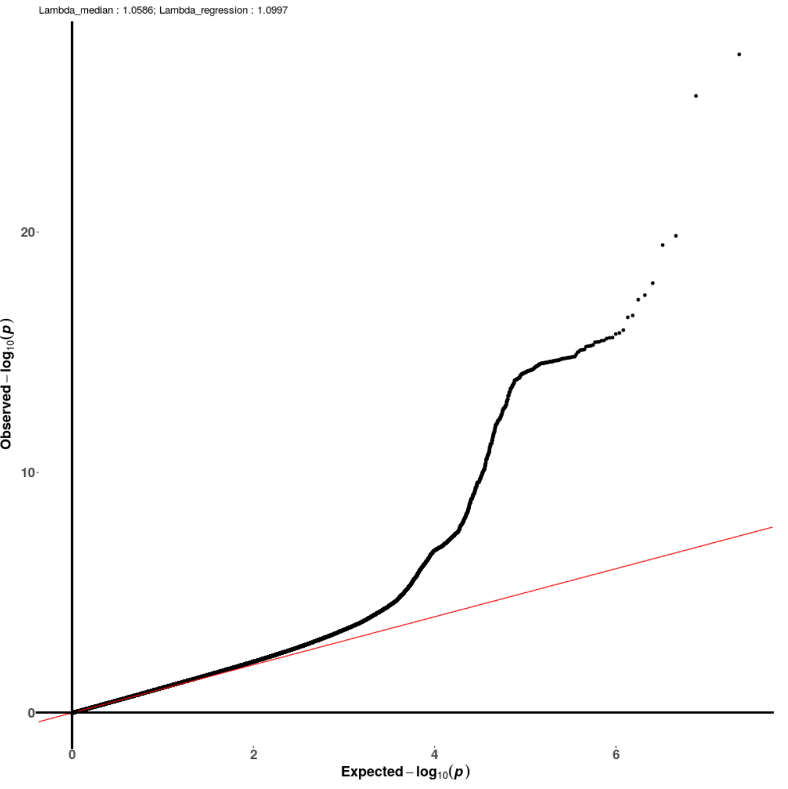
Variations
Kunkle et al. Nat. Genet. 2019

Slide 17
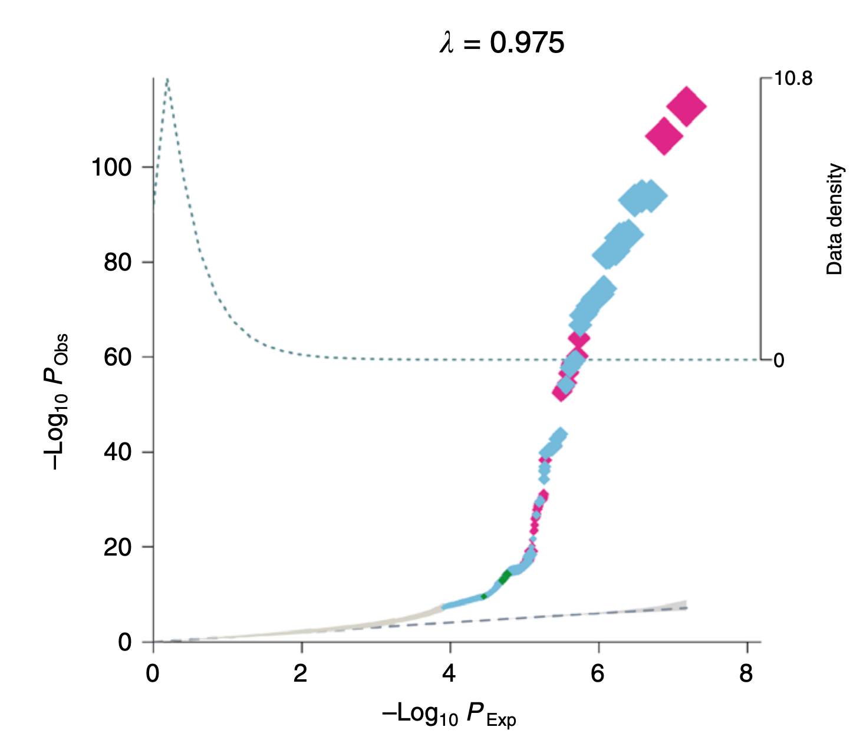
Variations
Highlighting with size and color
Bonàs-Guarch et al. Nat. Commun. 2018

Slide 18
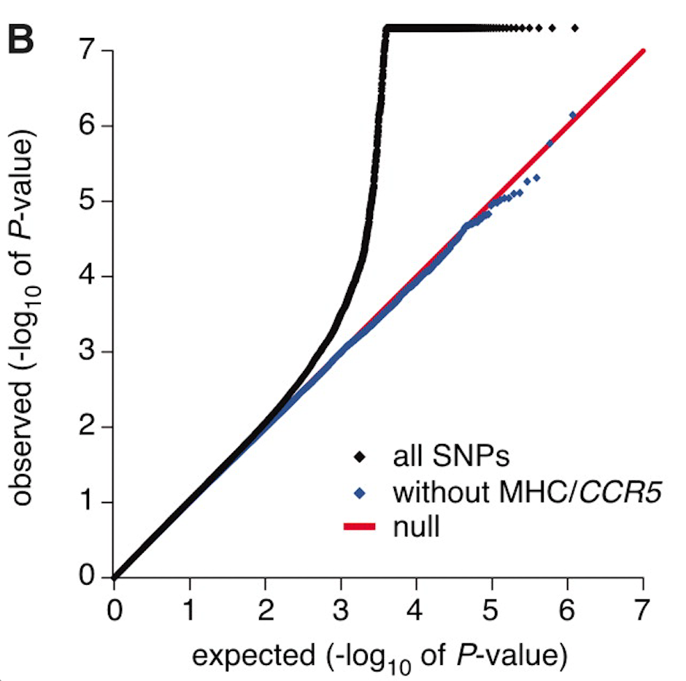
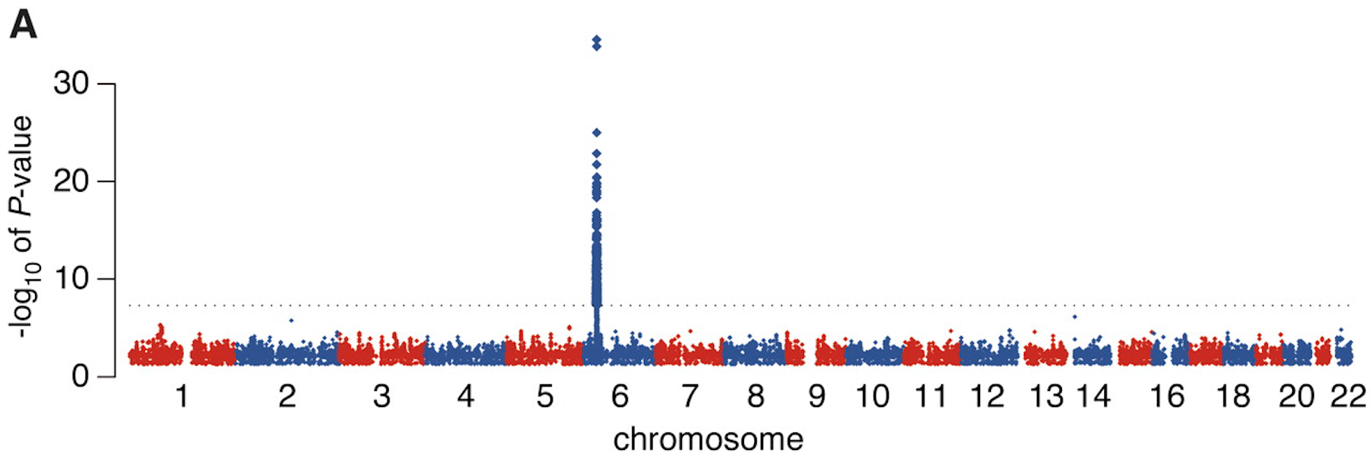
Variations
Subsetting
International HIV Controllers Study; Pereyra et al. Science 2010

Slide 19
Vector vs Raster Graphics
Vector graphics are usually preferable for visualizations
Generally, do not use vector graphics solutions for QQ plots.
(PDF, SVG, EPS)
Use raster graphics
(PNG, JPG, GIF)

Slide 20
Regional Manhattan Plots

Slide 21
Regional Manhattan Plots
Visualize small segment of genome

Slide 22
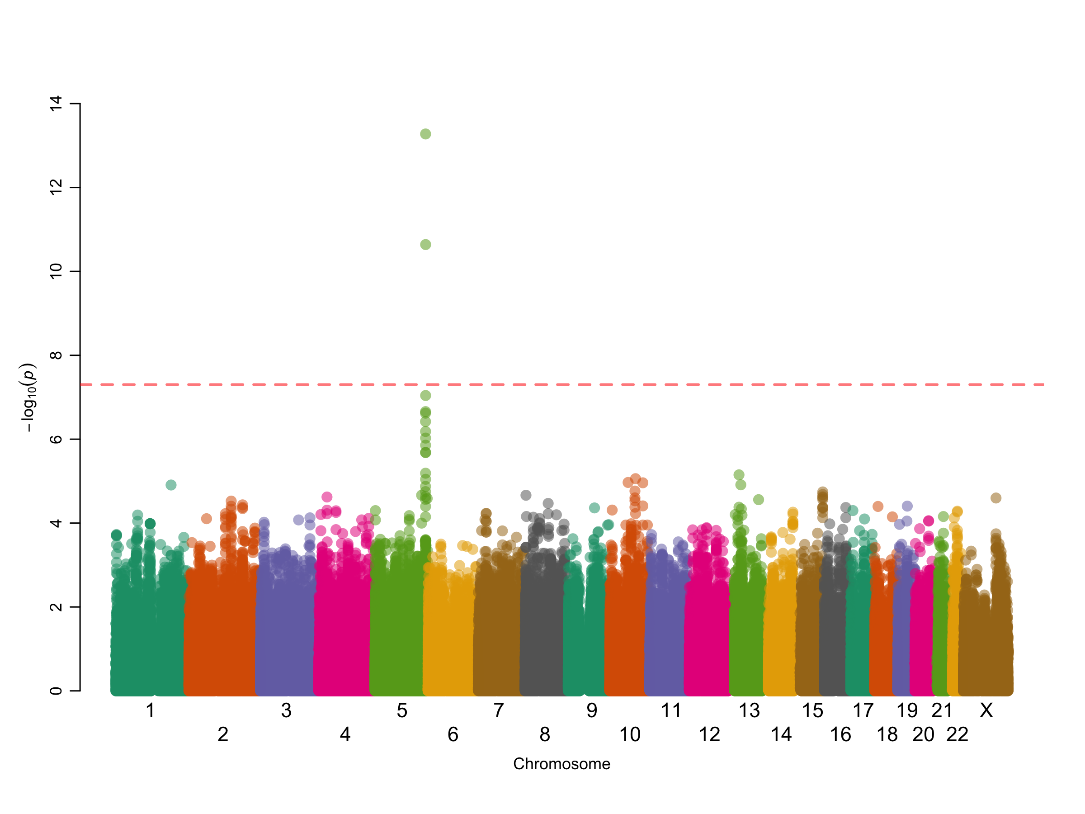

Slide 25
Principles
x axis: genomic position (chr:bp)
y axis: −log₁₀ p
Point colors
LD (usually r ²) between a “peak” SNP and the others
Reference lines
Genome-wide statistical significance (5 × 10⁻⁸)
Suggestive significance (often 10⁻⁵ or 10⁻⁶)
Often an overlay of recombination rate (to highlight recombination hotspots)
Often underlaid with genome map include gene diagrams

Slide 26
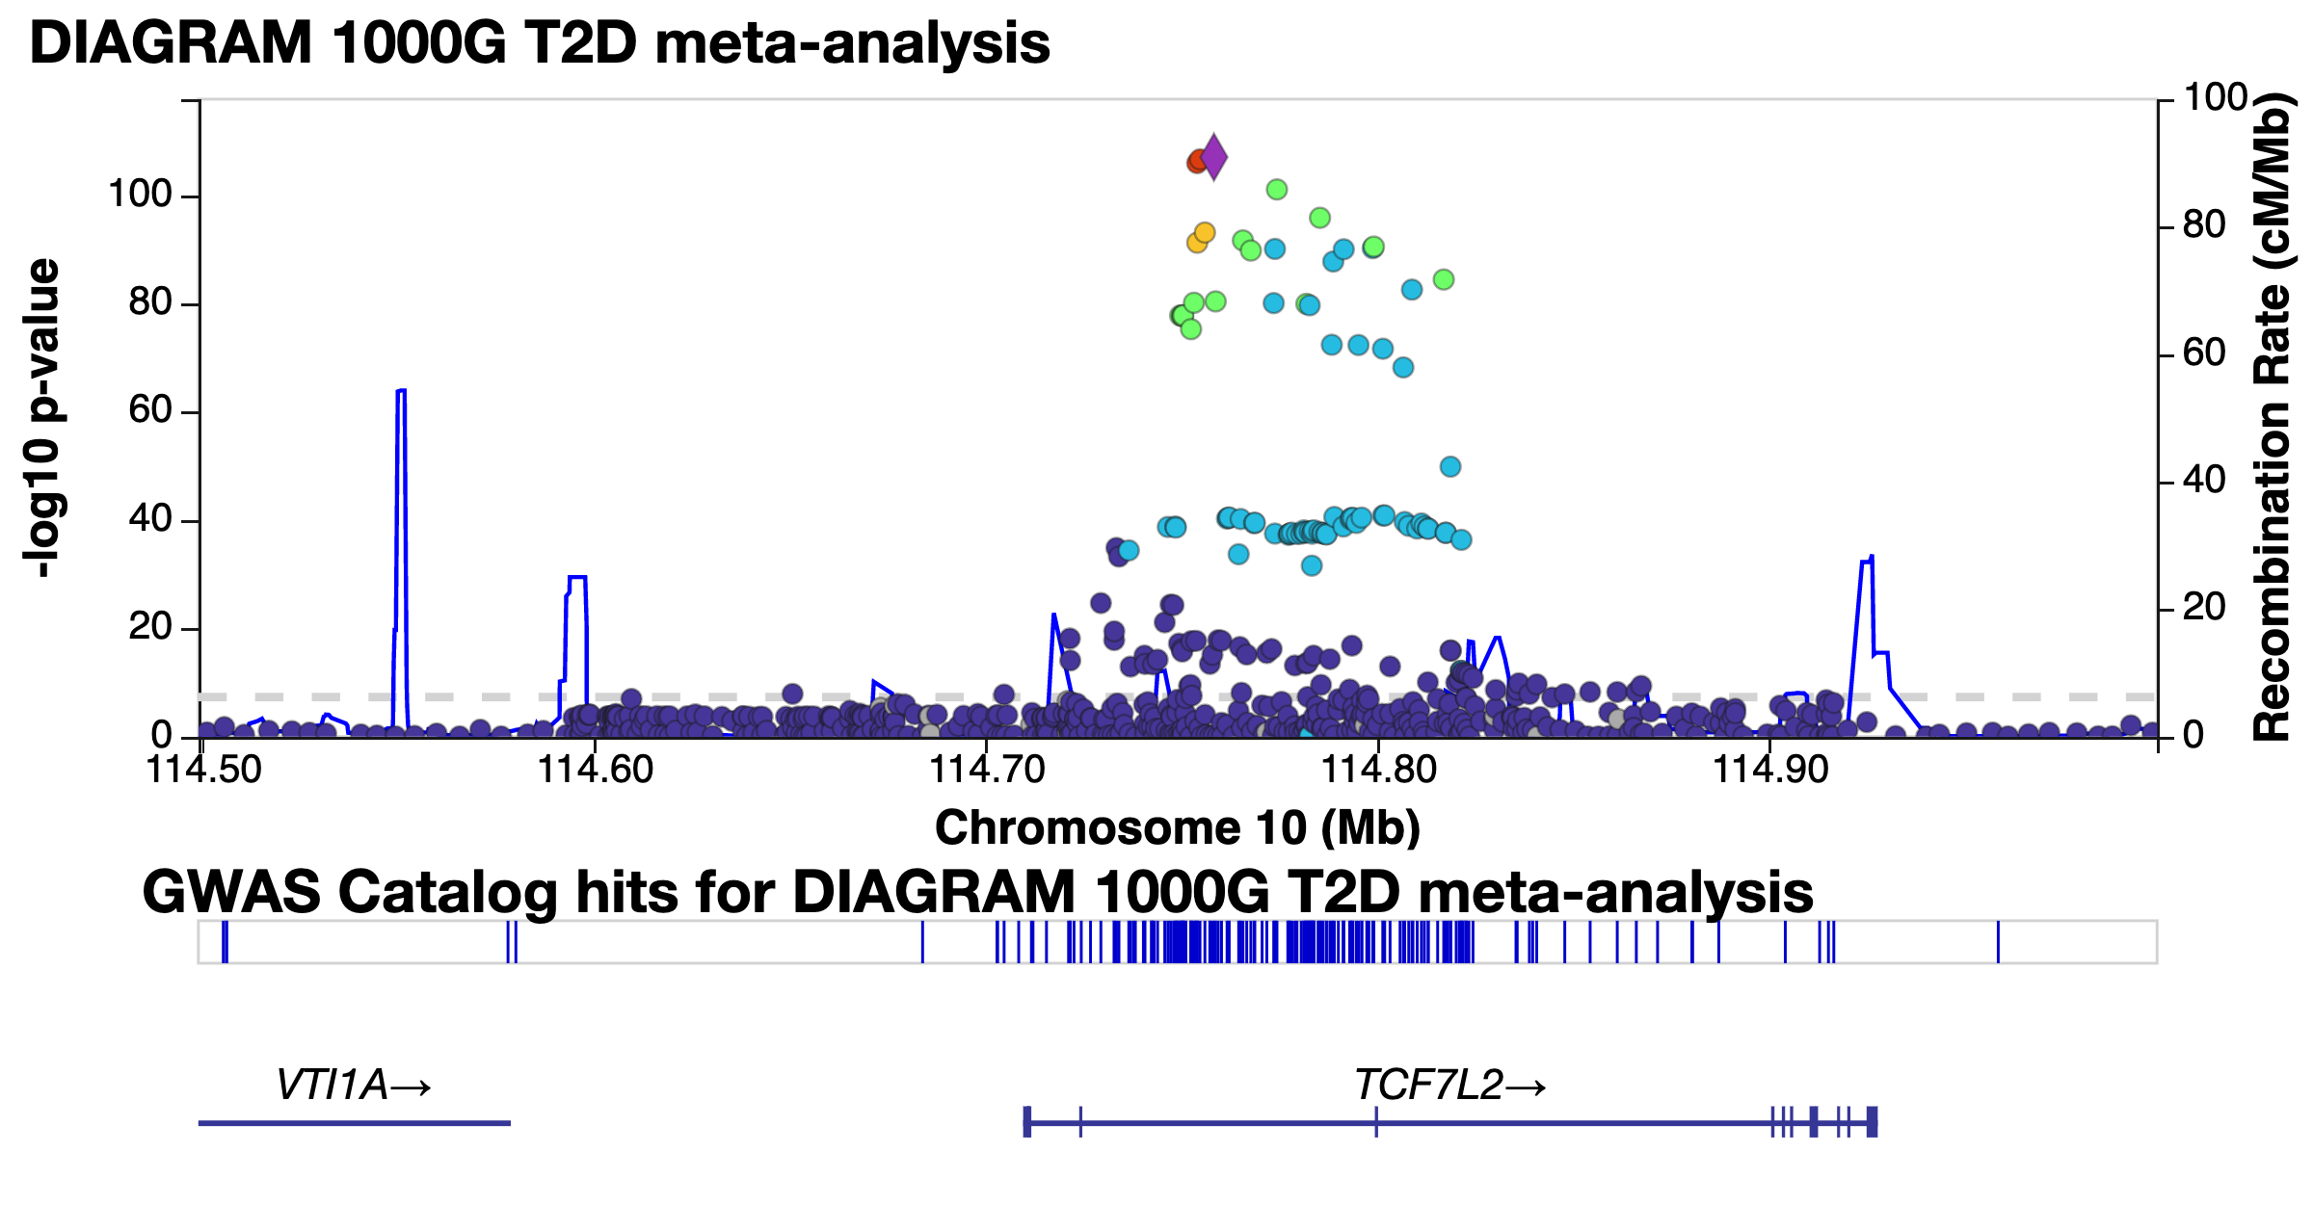

Slide 27
LocusZoom
(So you don’t have to code it yourself)
LocusZoom locuszoom.org Pruim et al. Bioinformatics 2010

Slide 28
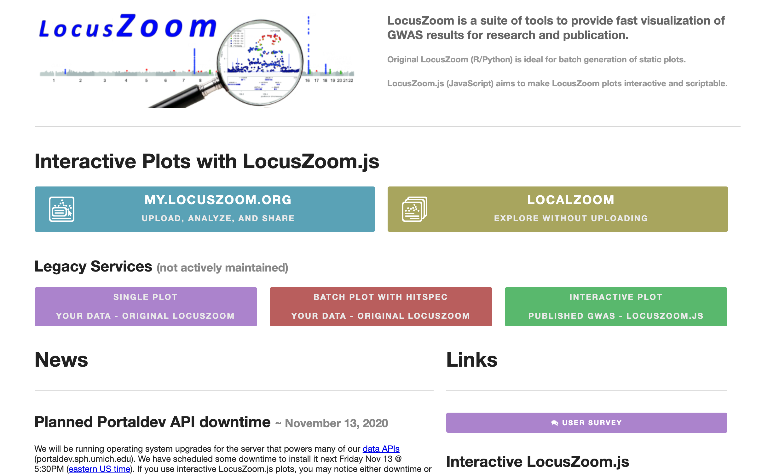

Slide 29
LocusZoom
Upload tab-delimited files with
Chromosome
Position
Reference allele
Alternate allele
p value or −log₁₀ p
Will highlight regions above a threshold for LocusZoom plots

Slide 30
Reference SNP against which all others are colored for LD (usually peak SNP)
Other SNPs colored by LD with the reference SNP
Recombination
Hotspots
Genes nearby

Slide 31
Standalone LocusZoom
There is a (no longer maintained) standalone version of LocusZoom
Command line interface via Unix, built with Python and R
https://genome.sph.umich.edu/wiki/LocusZoom_Standalone

Slide 32
ggbio

Slide 33
Plotting an Ideogram
library(ggbio) plotIdeogram(genome = "hg38", subchr = "chrX")

Slide 34
Plotting an Ideogram
library(ggbio) plotIdeogram(genome = "hg38", subchr = "chr19", which = GRanges(seqnames = "chr19", IRanges(44905791, 44909393))

Slide 35
Plotting an Ideogram
library(ggbio) plotIdeogram(genome = "hg38", subchr = "chr19", color = "blue", fill = "blue", which = GRanges(seqnames = "chr19", IRanges(43905791, 45909393))

Slide 36
Plotting Genes
library(EnsDb.Hsapiens.v86) autoplot(EnsDb.Hsapiens.v86, ~ symbol = "BRCA1", names.expr = "gene_name")

Slide 37
Plotting Regions
library(EnsDb.Hsapiens.v86) gr <- GRanges(seqnames = 19, IRanges(44895791, 44919393), strand = "*") autoplot(EnsDb.Hsapiens.v86, GRangesFilter(gr), names.expr = "gene_name")

Slide 38
Exercise
Download summary statistics for a GWAS of your choice from https://www.ebi.ac.uk/gwas/downloads/summary-statistics
Read the data into R
Create Manhattan and Q-Q plots
Try two packages
qqman (https://cran.r-project.org/web/packages/qqman/vignettes/qqman.html)
GWASTools
Installation instructions: https://www.bioconductor.org/packages/release/bioc/html/GWASTools.html
Plotting functions:
https://rdrr.io/github/smgogarten/GWASTools/man/qqPlot.html
https://rdrr.io/bioc/GWASTools/man/manhattanPlot.html
Save them as appropriate file types
Can you speed up the plotting?
Can you customize the plots at all?

